Slide 1
Build Web Games
Chapter 9: Add more contents

Slide 2
HTML document structure
<!DOCTYPE html>
<html>
<head>
<title>
</title>
<style>
</style>
</head>
<body>
<div>
</div>
<script>
</script>
</body>
</html>

Slide 3
Loop through an array
Arrays are often used with loops to process each element one by one.
A common loop used with arrays is the for loop:
let names = ["Chloe", "Arthur", "Sophie", "Aiden", "Jerry", “Marco", "Henry"];
for(let i=0; i < names.length; ++i) {
console.log("Name[", i, "] = ", names[i]);
}
// Name[ 0 ] = Chole
// Name[ 1 ] = Arthur
// Name[ 2 ] = Sophie
// Name[ 3 ] = Aiden
// Name[ 4 ] = Jerry
// Name[ 5 ] = Marco
// Name[ 6 ] = Henry

Slide 4
2D array - an array of arrays
// Create a 2D array (matrix)
const matrix = [
[1, 2, 3],
[4, 5, 6],
[7, 8, 9]
];
// Access elements in the 2D array
console.log(matrix[0][0]); // Element in 1st row and 1st colum (1)
console.log(matrix[1][2]); // Element in 2nd row and 3d column (6)
// Find the number of rows and columns
console.log(matrix.length); // Number of rows (3)
console.log(matrix[0].length); // Number of columns (3)
// Modify elements in the 2D array
matrix[1][1] = 10; // Change the value at 2nd row and 2nd // Iterate through the 2D array
for (let i = 0; i < matrix.length; i++) {
for (let j = 0; j < matrix[i].length; j++) {
console.log(matrix[i][j]);
}
}
// Add a new row to the 2D array
matrix.push([10, 11, 12]);
// Remove a row from the 2D array
matrix.pop(); // Remove the last row

Slide 5
HTML content statically defined
<div>
<div class="row">
<div id="0_0" onclick="onElementClicked(this)"></div>
<div id="1_0" onclick="onElementClicked(this)"></div>
<div id="2_0" onclick="onElementClicked(this)"></div>
</div>
<div class="row">
<div id="0_1" onclick="onElementClicked(this)"></div>
<div id="1_1" onclick="onElementClicked(this)"></div>
<div id="2_1" onclick="onElementClicked(this)"></div>
</div>
<div class="row">
<div id="0_2" onclick="onElementClicked(this)"></div>
<div id="1_2" onclick="onElementClicked(this)"></div>
<div id="2_2" onclick="onElementClicked(this)"></div>
</div>
</div>

Slide 6
Create tic tac toe contents
function createElements(numRows = 3, numColums = 3) {
const ticTacToeRoot = document.createElement("div");
document.body.appendChild(ticTacToeRoot);
for (let rowId = 0; rowId < numRows; ++rowId) {
// Add <div class="row"/>
const rowDiv = document.createElement("div")
rowDiv.classList.add("row");
ticTacToeRoot.appendChild(rowDiv)
for (let columnId = 0; columnId < numColums; ++columnId) {
const blockDiv = document.createElement("div")
blockDiv.onclick = onElementClicked;
blockDiv.id = columnId.toString() + "_" + rowId.toString();
rowDiv.appendChild(blockDiv);
}
}
}
<div>
<div class="row">
<div id="0_0" onclick="onElementClicked(this)"></div>
<div id="1_0" onclick="onElementClicked(this)"></div>
<div id="2_0" onclick="onElementClicked(this)"></div>
</div>
<div class="row">
<div id="0_1" onclick="onElementClicked(this)"></div>
<div id="1_1" onclick="onElementClicked(this)"></div>
<div id="2_1" onclick="onElementClicked(this)"></div>
</div>
<div class="row">
<div id="0_2" onclick="onElementClicked(this)"></div>
<div id="1_2" onclick="onElementClicked(this)"></div>
<div id="2_2" onclick="onElementClicked(this)"></div>
</div>
</div>

Slide 7
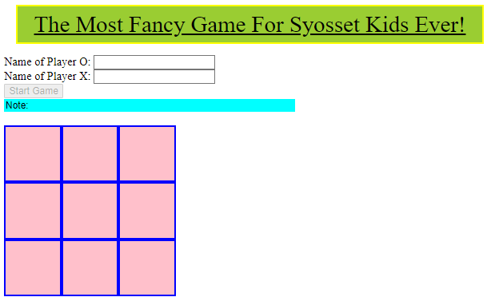
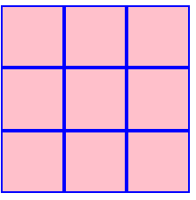
Add more contents

Slide 8
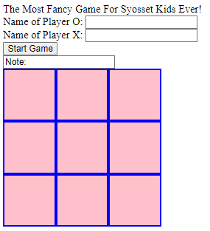
Add more contents – add HTML elements
<header>
The Most Fancy Game For Syosset Kids Ever!
</header>
<form>
<div>
<label for="oName">Name of Player O: </label>
<input id="oName" type="text">
</div>
<div>
<label for="xName">Name of Player X: </label>
<input id="xName" type="text">
</div>
<input id="startGame" type="button" value="Start Game"> <br/>
<input id="idNote" type="text" value="Note: ">
</form>

Slide 9
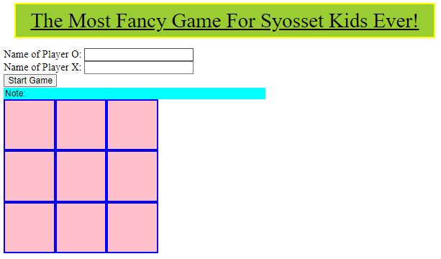
Add more contents – Style HTML elements
header {
font-size: 2em;
background-color: yellowgreen;
text-decoration: underline;
text-align: center;
margin: 0.5em;
padding: 0.2em;
border: 3px solid yellow;
}
#idNote {
border: none;
width: 400px;
background-color: aqua;
}

